Slide 1
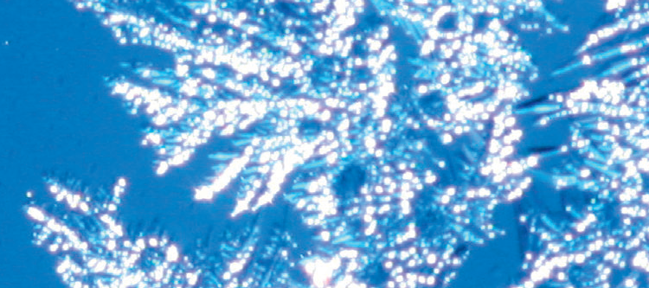
Chapter 6: Water and the intermolecular forces

Slide 2
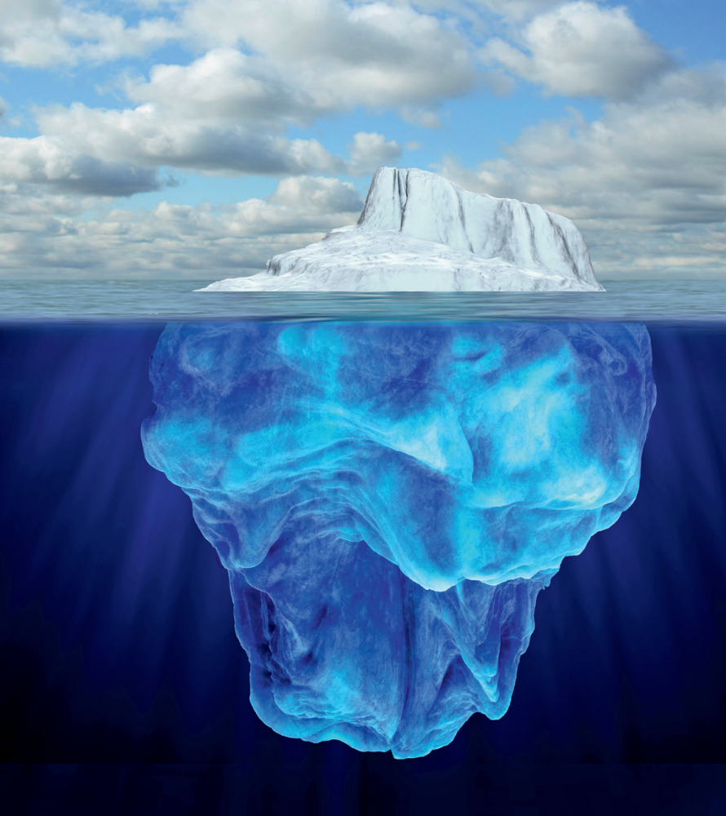
Water: the vital substance
Unique properties of water:
Boiling point
Density (solid and liquid)
Surface tension
Ability as a solvent
All due to intermolecular forces.

Slide 3
Water and intermolecular forces
Intermolecular forces
much weaker than covalent bonds
The structure and composition of molecules determines which intermolecular forces are present.
Notes:
Intermolecular forces between molecules are much weaker than covalent bonds within molecules. The structure and composition of molecules determines which intermolecular forces are present. These forces determine the properties of the material.

Slide 4
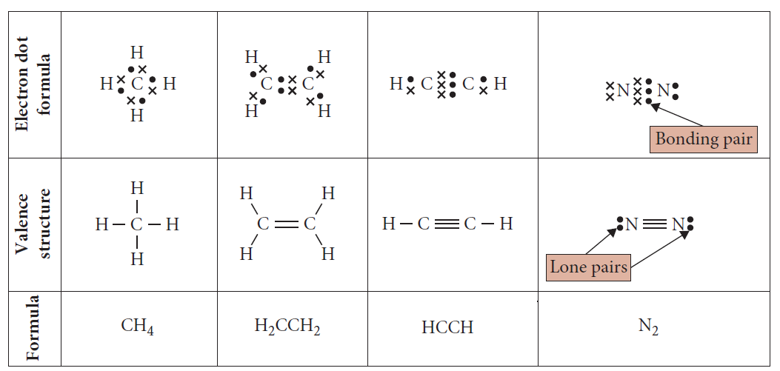
Representing molecules
Shapes of molecules
The structure of molecules can be shown by:
Notes:
The shapes of molecules can be explained and predicted using three-dimensional representations of electrons as charge clouds and using valence shell electron pair repulsion (VSepr) theory (ACSCH056)

Slide 5
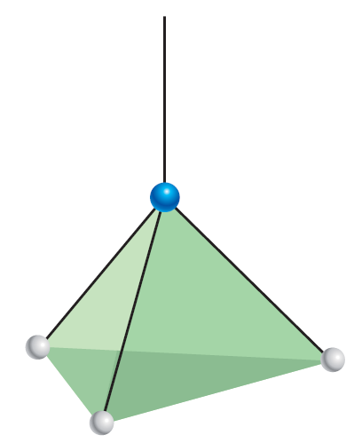
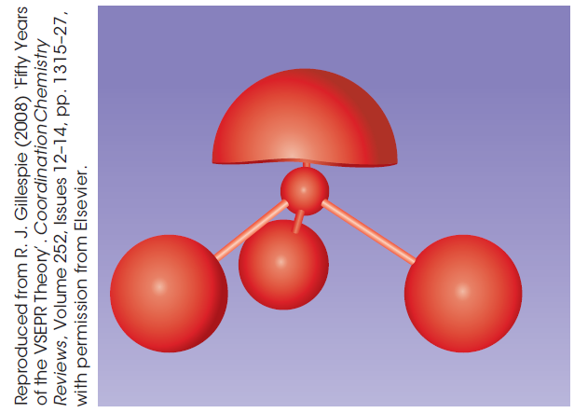
VSEPR shape of molecules
Predicting the shape of molecules
VSEPR is based upon
the number of electron pairs surrounding the central atom
The electrons pairs arrange themselves as if they repel each other.

Slide 6
To work out the shape
Draw the electron dot figure.
Count the lone pairs and bonding pairs.
Remember that lone pairs are electron pairs that are not shared.
Bonding pairs form the covalent bonds.

Slide 7
To work out the shape
Treat the electrons in a covalent bond, whether a single, double or triple bond as one set of electrons.
Use Table C6.1 to predict the shape based upon the number of bonding and lone pairs.

Slide 8
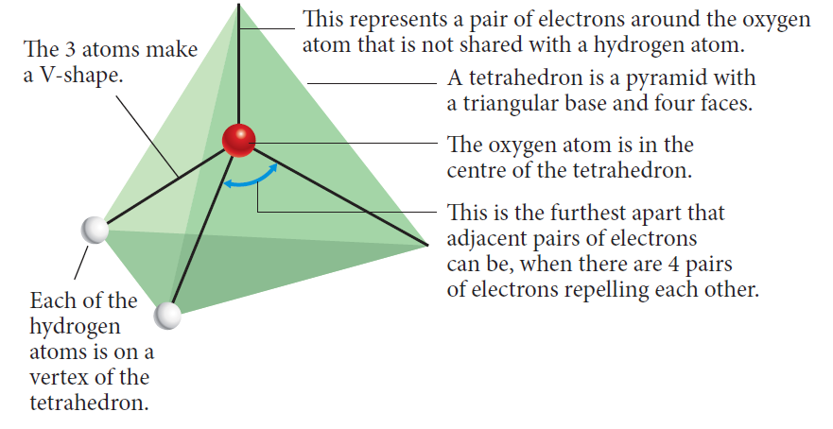
Notes:
The shape and polarity of molecules can be used to explain and predict the nature and strength of intermolecular forces, including dispersion forces, dipole-dipole forces and hydrogen bonding (ACSCH058)

Slide 9
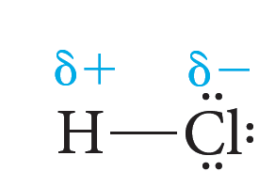
Uneven electron sharing
When H or C bond covalently with O, F, N or Cl
The electrons are not shared evenly
Polar covalent bonds are formed
a dipole is formed
Relative electronegativity strength indicates if the bonding will be ‘unfair’
F>O>N=Cl>Br>C=S=I>P=H>Si

Slide 10
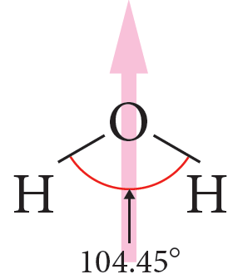
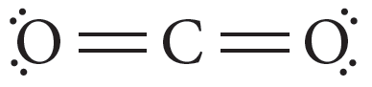
Polar molecules form when there is
Polar covalent bonds & Asymmetry
Symmetry Asymmetry
Non-polar Polar

Slide 11
Three types of intermolecular forces
All bonding is due to the attraction of opposites
(Electromagnetic attraction)
There are three types of intermolecular forces
Dipole-dipole forces
Hydrogen bonds
Dispersion forces

Slide 12
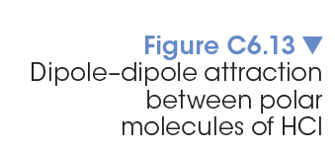
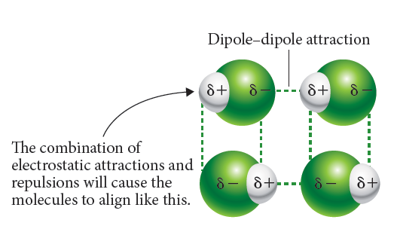
Dipole–dipole forces
occur when a permanent dipole is present.

Slide 13
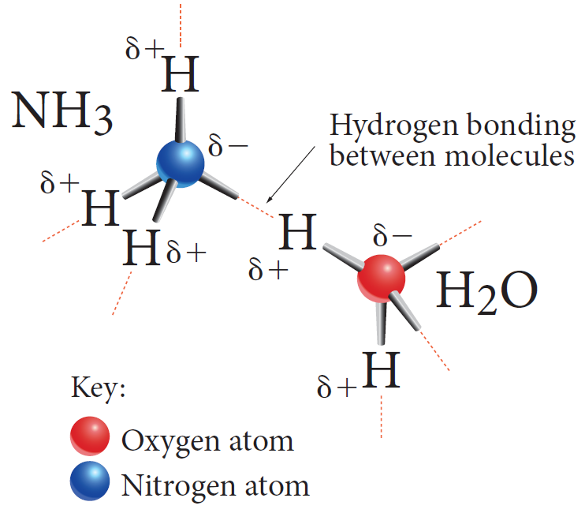
Hydrogen bonding: a special Dipole–dipole force
Hydrogen bonded to a O, N or a F atom in one molecule is attracted to the lone pair of electrons on N, O or F in an adjacent molecule.

Slide 14
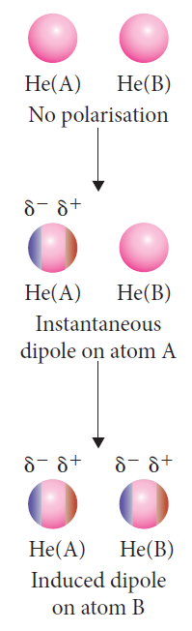
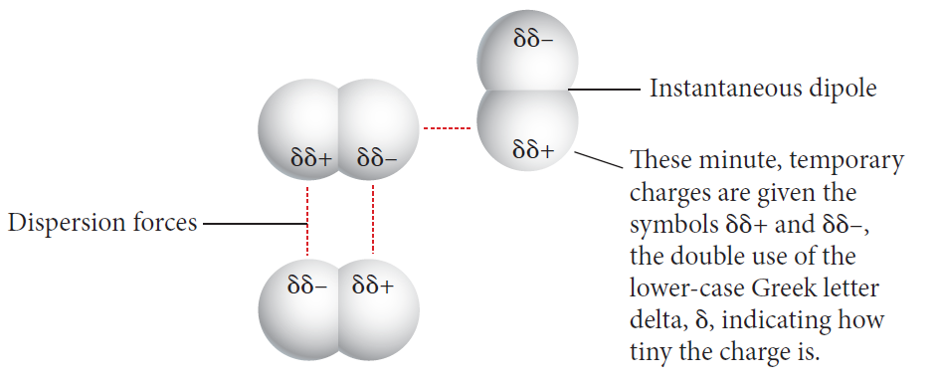
The weakest force: dispersion force
Instantaneous dipoles are formed due to the movement of electrons.
These temporary dipoles cause the electrostatic attraction in dispersion forces.
Notes:
Instantaneous temporary dipole due to the movement of electrons explains the existence of the dispersion forces. With more electrons the dispersion force is stronger and the boiling point is higher.

Slide 15
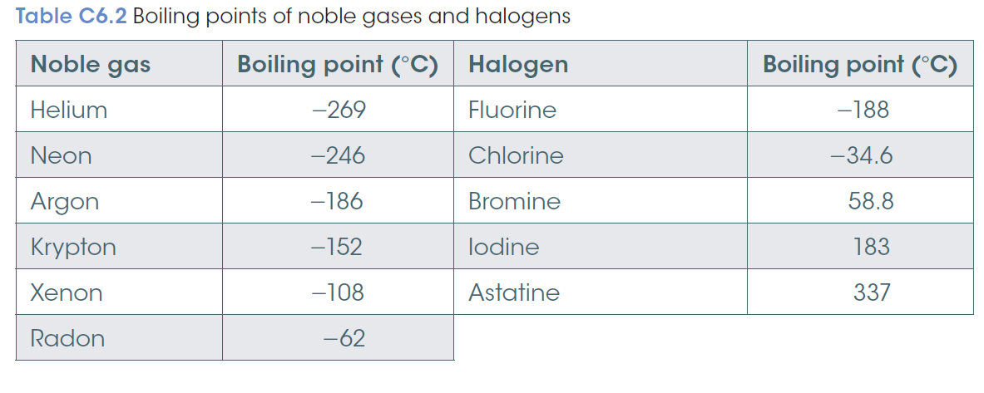
More electrons
= more chance for instantaneous temporary dipoles
= higher boiling point

Slide 16
The importance of bonding
The unique properties of water include unusual melting and boiling points, vapour pressure, density in solid and liquid phases, surface tension and an ability to act as a very good solvent are due to the strength of hydrogen bonds.
A large amount of energy is needed to break the hydrogen bonds.

Slide 17
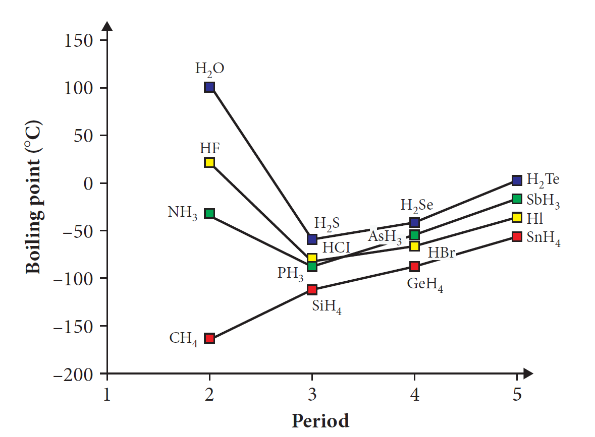
Hydrogen bonding explains ...
Explains water’s:
high boiling point
high latent heat (change state)
high specific heat capacity
lower vapour pressure.

Slide 18
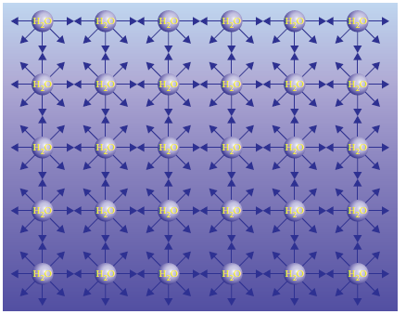

High surface tension
The surface tension of water is high as hydrogen bonding occurs in all directions and is relatively strong. It holds the molecules together.

Slide 19
Capillary action is due to:
cohesive force – the intermolecular force between molecules in a substance that helps to maintain a certain shape of the liquid.
surface tension – this is due to the cohesive forces at the surface of material and results in the surface of the fluid being under tension.
adhesive force – these are the forces of attraction between unlike molecules.

Slide 20
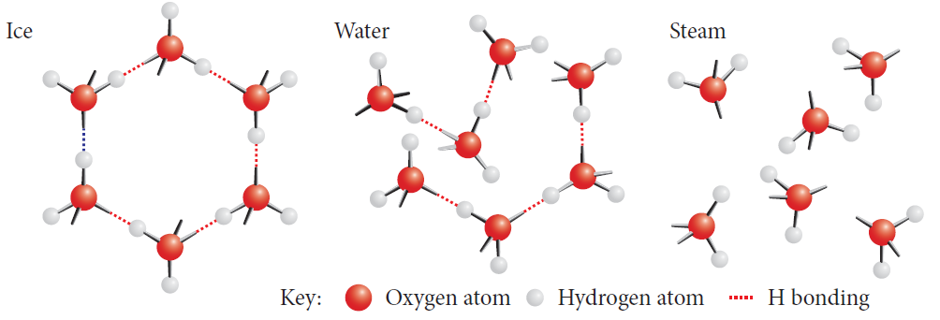
Water expands as it freezes. At less than 4°C, the molecules do not have as much kinetic energy and no longer move between the spaces, but form more hydrogen bonds.
The shape of the water molecule means a regular hexagonal shape is formed.

Slide 21
Water is the universal solvent
Pure water is liquid from 0°C to 100°C.
This means that it can act as a solvent over this temperature range.
Water dissolves and transports a range of material across the whole planet and also through each cell of a living organism.

Slide 22
Water dissolve polar substances by forming
ion-dipole,
dipole-dipole or
hydrogen bonds
with the substance

Slide 23
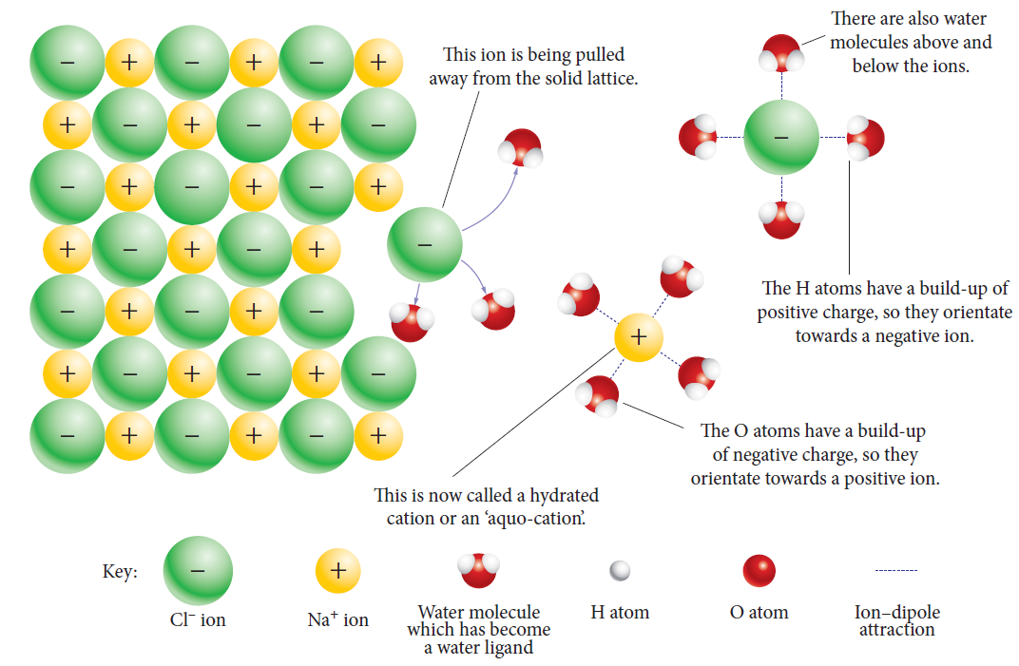
Water dissolving a salt
Solutes

Slide 24
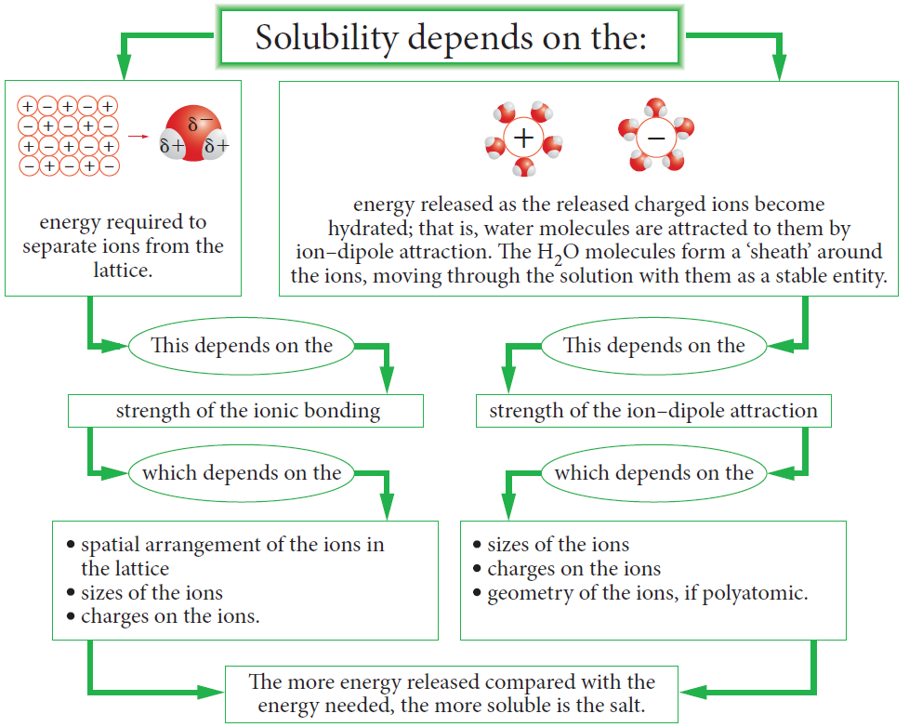
Solutes
Notes:
A solute dissolves when the energy of the bonds it forms with water is lower than the energy of the bonds between the water molecules or between the water molecules and the ions of the substance being dissolved. The energy difference explains why some polar salts dissolve in water and some don’t.

Slide 25
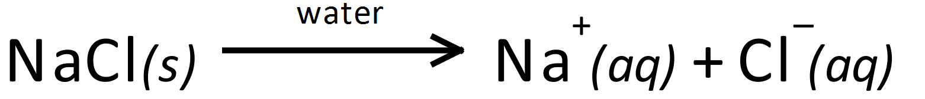
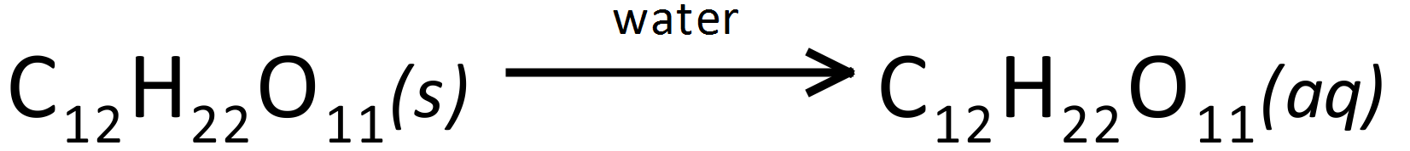
Solution equations

Slide 26
Measuring solubility
Saturated solution:
Maximum amount of grams that can dissolve in 100 g of water at that temperature
Unsaturated solution:
Below the curve/more can dissolve
Supersaturated solution:
Above the curve /Unstable solution

Slide 27
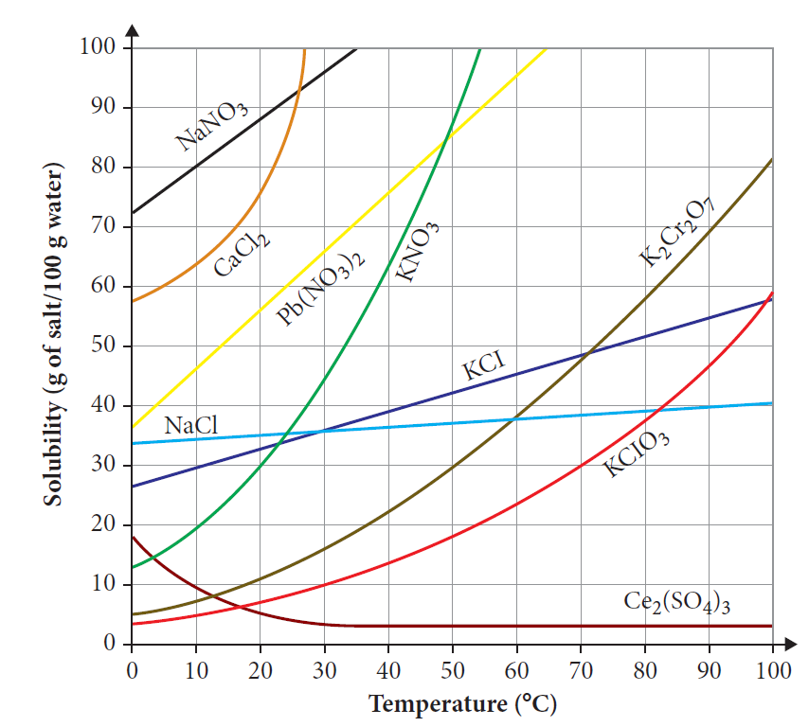
Solubility curves

Slide 28
Concentration
Measures the amount of solute present
g/100g,
% v/v, % w/w, % v/w,
ppm (parts per million)

Slide 29
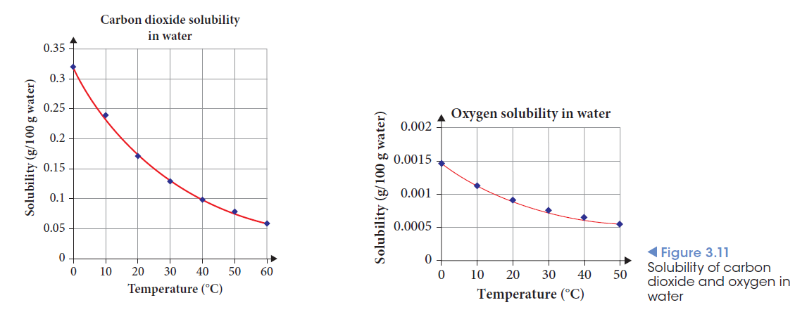
Solubility of gases

Slide 30
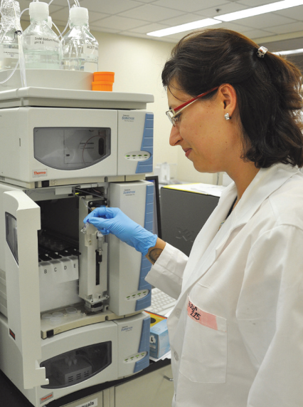
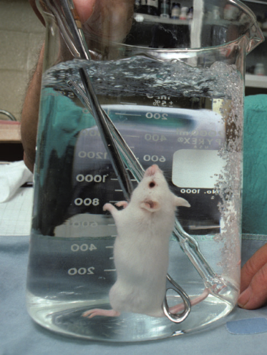
Practical applications
Surfactants
Detergents
Chromatography
Thin Layer Chromatography
Gas Chromatography
High Performance Liquid Chromatography

Slide 31
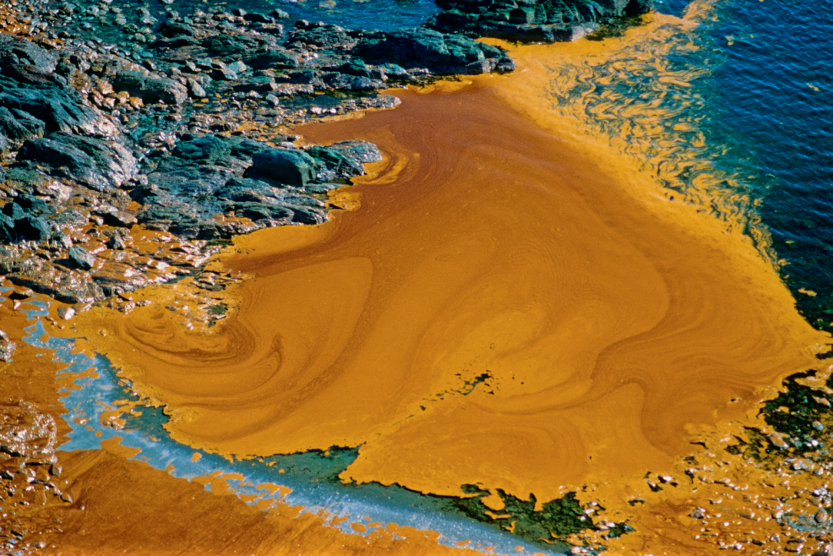
Like dissolves like.
Polar solvents dissolve polar substances.
Non-polar solvents dissolve non-polar solutes

Slide 32
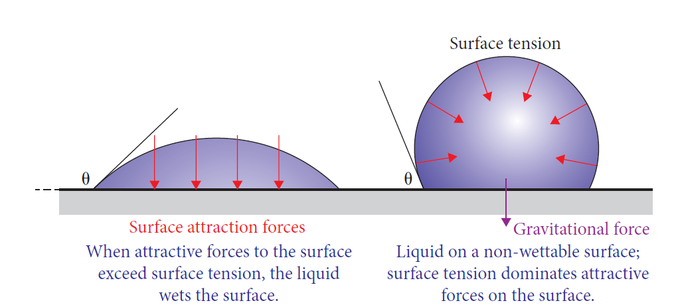
Surfactants
Surfactant
Surfactants such as detergents interrupt the surface tension of water.

Slide 33
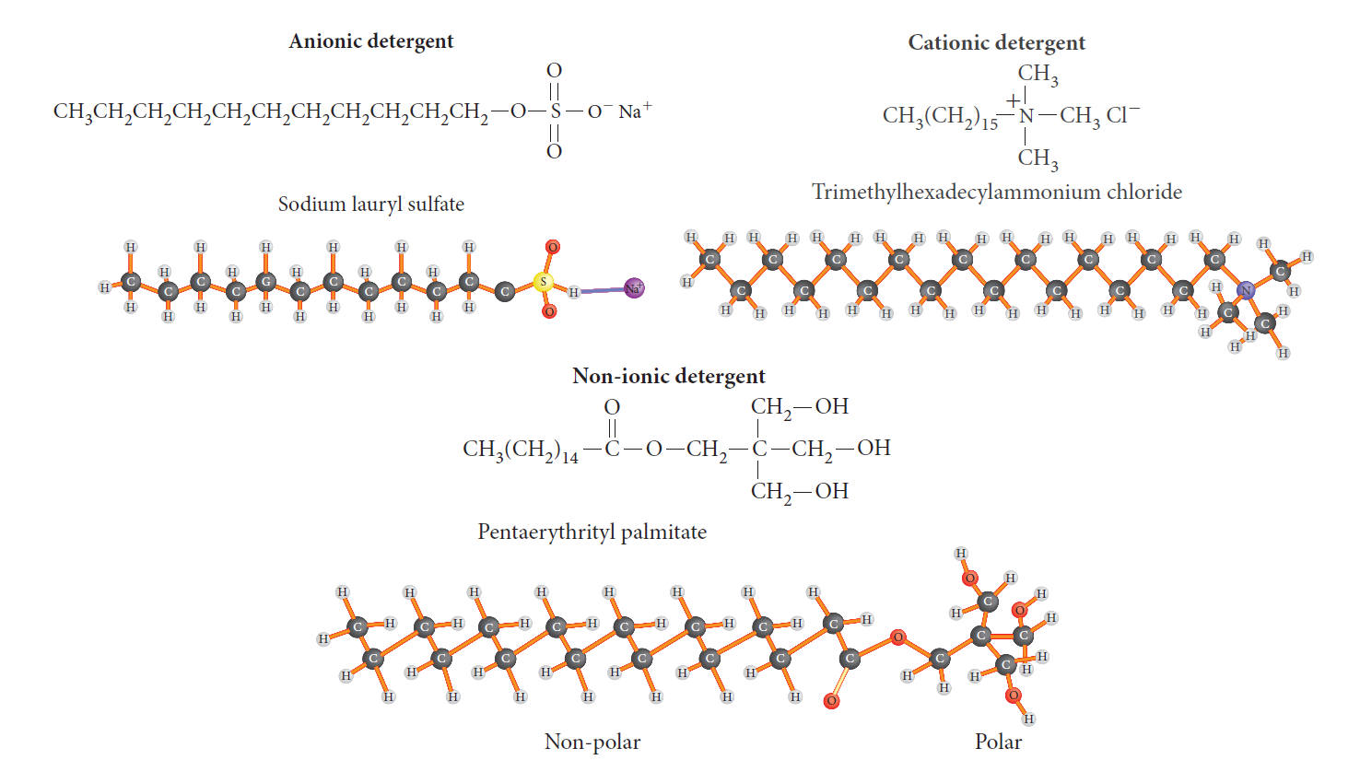
Surfactants
Surfactant molecules detergents
Surfactants have both polar and non-polar regions.

Slide 34
Chromatography is the name of the group of techniques that separate substances based upon differential distribution between a stationary phase and a mobile phase.

Slide 35
Different substances will adsorb onto a surface and desorb into a solvent at different rates.
Separation is done by altering the solvent (mobile phase) and the surface (stationary phase)

Slide 36
This difference is due to:
the different types of polar groups
the amount of charged and polar chemical groups present
its molecular weight
its geometry
the positions and numbers of carbon–carbon double bonds

Slide 37
Thin-layer chromatography
The solvent (mobile phase) moves up the stationary phase, due to capillary action.
The particles most attracted to the stationary phase move the slowest.
The particles that are more strongly attracted to the solvent move the fastest.

Slide 38
The retardation factor R_{f}
Distance travelled by the sample from the origin divided by the distance the solvent has moved
Between 0 & 1
Standards used to confirm identity of the sample as the R_{f} is characteristic for a substance

Slide 39
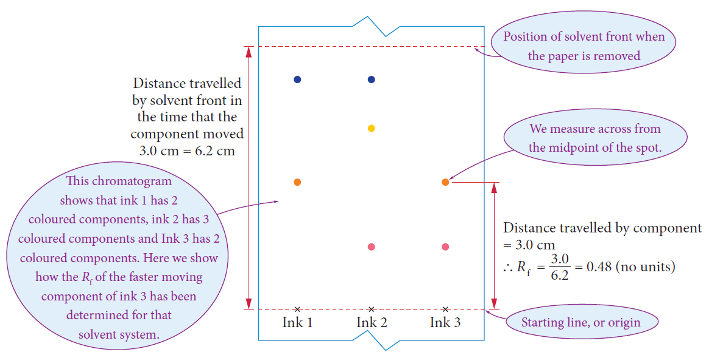

Slide 40
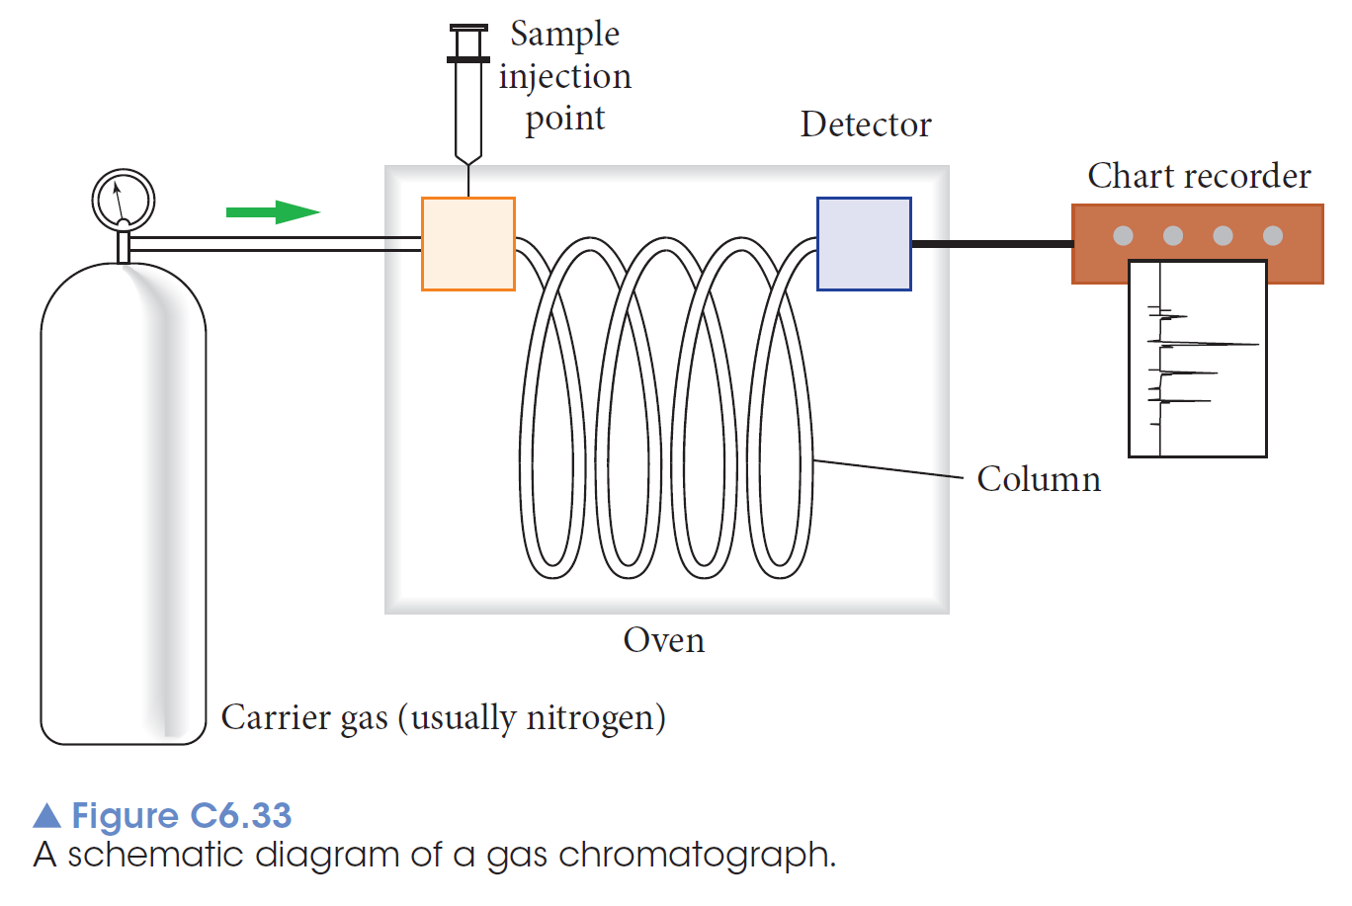
Gas chromatography
For small organic molecules that can withstand relatively high temperatures
Rt, the retention time is characteristic for the substance

Slide 41
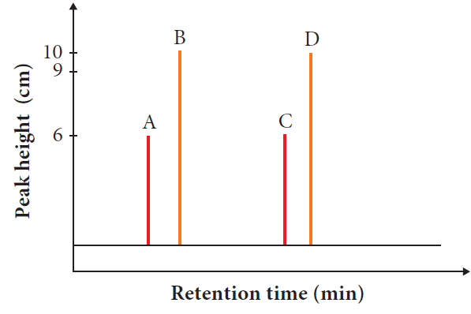
Mobile phase carrier gas
Stationary phase column
Smaller solutes that absorb the least elute first.

Slide 42
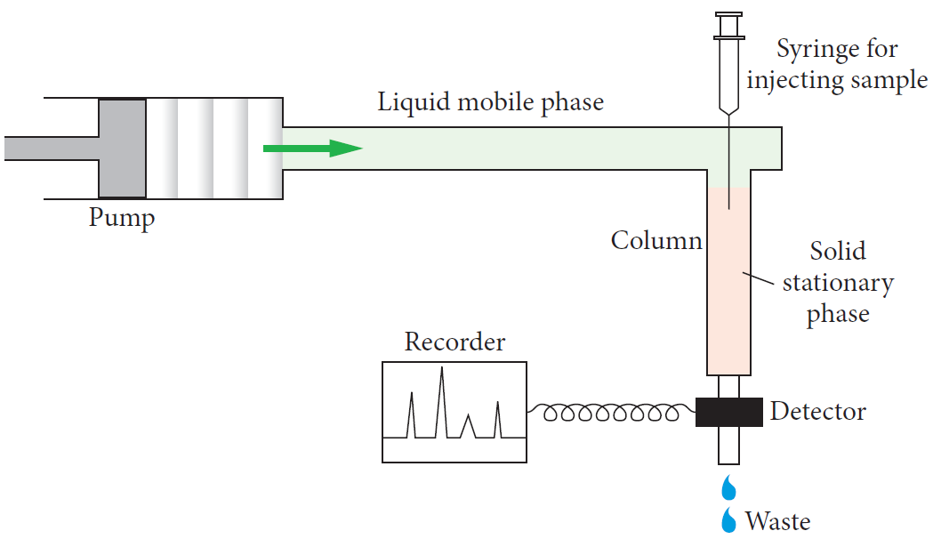
High-performance liquid chromatography (HPLC)
Used for larger organic or heat unstable molecules.
The stationary column is shorter than in the gas chromatograph.
The mobile phase is a liquid not gas.
A pump is used because pressure is required to move the liquid through the column.

Slide 43
Both GC and HPLC
Quantitative analysis
The amount under the peak indicate the amount of solute present.
A series of standards can be run to produce a calibration curve.
The amount of the unknown can be read off the graph.
Use Rt values to identify compounds,
standards are run to confirm the identity (same Rt)

Slide 44
